Slide 1
The Battle of Neighborhoods
Where to eat for cheap in Curitiba

Slide 2
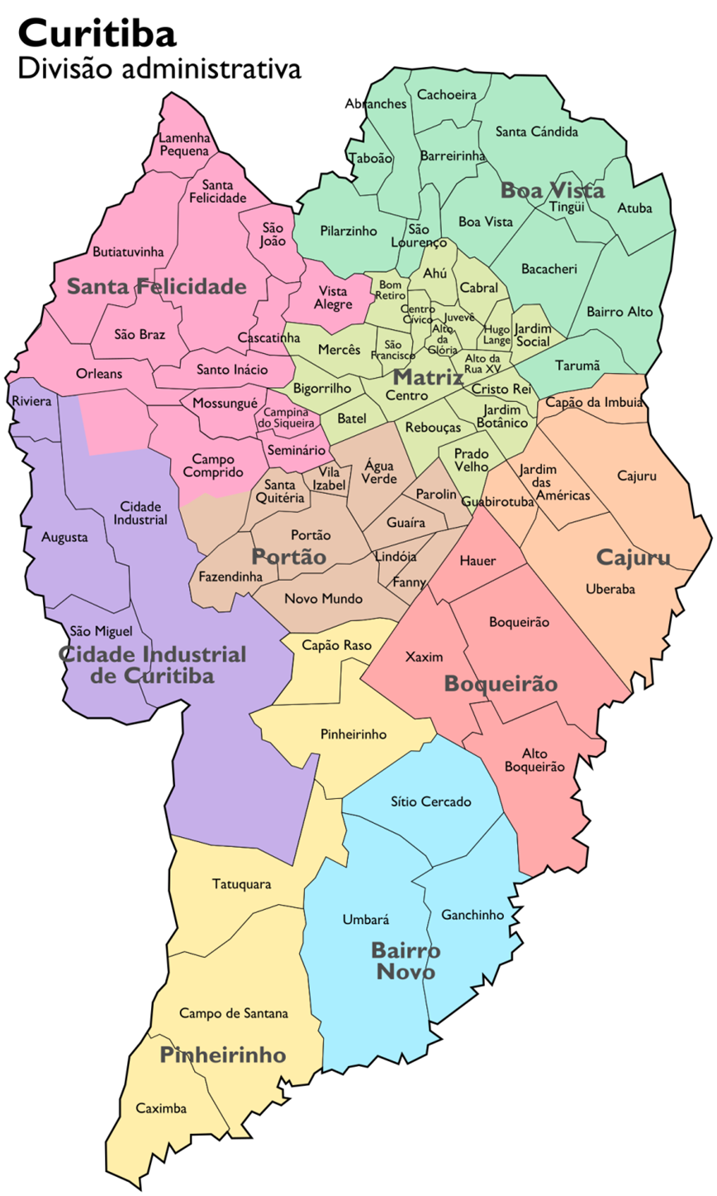
Introduction
Curitiba is one of the most important cities in the southern part of Brazil. As capital of the state of Paraná, the city has more than 1,800,000 habitants and covers an area of 430.9 km². It is the 7th largest Brazilian city and 4th largest in the Southern Cone (the south part of South America). The city has the largest population and the largest economy in Southern Brazil.[5] The urban area of Curitiba is looked after by 26 local governments and has 3,335,588 people living there.
Curitiba is a city in south Brazil, capital of Paraná. It has 75 neighborhoods, divided into 9 administrative regions. The city itself has a population of 1.9 million people. It's continuously built-up urban area, is the eighth largest city in Brazil.
Curitiba is considered a leading regional city, with a strong market, culture, art, finance and education areas. Its industrial district hosts larges national and international companies, over last decades the district is continuously growing because of the city’s important role in government and commercial business.

Slide 3
Objectives
In this project I would like to help tourists or even residents with an analysis of the rated restaurants distribution and finally with a quick guide of the best places and region to eat for cheap in Curitiba.
Some questions we are looking to answer:
Which areas/neighborhoods have more restaurants in Curitiba?
What are the best-rated restaurants to eat for cheap in Curitiba?
Is it possible to define the best location to eat for cheap in Curitiba?
Target audience:
People interested on eating well for less, tourists or residents who looks for a guide of great food for cheap. Business Analyst, who wish to analyze the neighborhoods of Curitiba using python, Jupiter notebook and some machine learning techniques.

Slide 4
Data Description
Data Requirements and Collection
1st Data: https://pt.wikipedia.org/wiki/Lista_de_bairros_de_Curitiba
The list of Curitiba neighborhoods, with area, population and average net income;
2nd Data: https://nominatim.openstreetmap.org/
Coordinates from each neighborhood;
3rd Data: https://developer.foursquare.com/
Restaurants lists database, containing Category, ID and coordinates;
4rd Data: https://developer.foursquare.com/
Restaurants ratings, likes, tips and price;

Slide 5
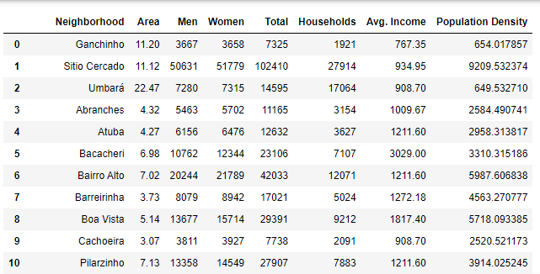
1st Data
1st Data: https://pt.wikipedia.org/wiki/Lista_de_bairros_de_Curitiba
The list of Curitiba neighborhoods, with area, population and average net income;
*First 10 items of our dataframe

Slide 6
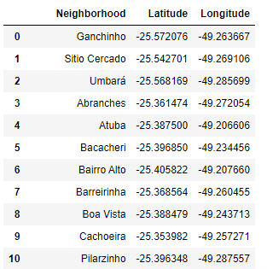
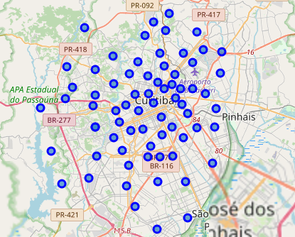
2nd Data
2nd Data: https://nominatim.openstreetmap.org/
Coordinates from each neighborhood;
*First 10 items of our dataframe
Neighborhood dataframe map

Slide 7
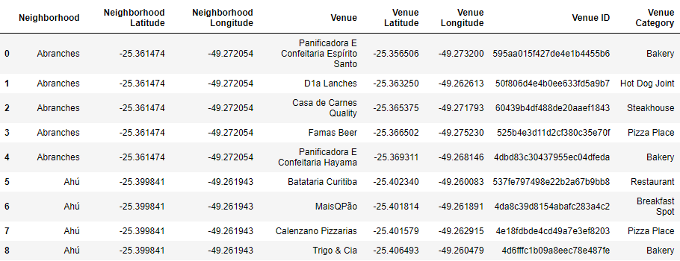
3rd Data
3rd Data: https://developer.foursquare.com/
Restaurants lists database, containing Category, ID and coordinates
*First 8 items of our dataframe

Slide 8
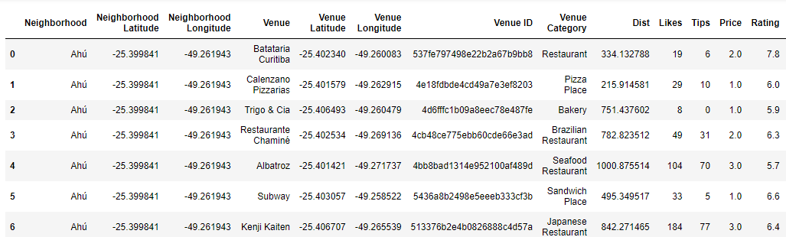
4rd Data
4rd Data: https://developer.foursquare.com/
Restaurants ratings, likes, tips and price;
*First 6 items of our dataframe

Slide 9
Methodology
Collect Inspection Data
Explore and Understand the Data
Data preparation and preprocessing
Modeling
Evaluation

Slide 10
Methodology
In this project we will direct our efforts on detecting areas of Curitiba that have high restaurant density, particularly those with high number of cheap and well evaluated restaurants, resulting in an interactive map of Where to Eat Well fot Cheap in Curitiba.
In first step we have collected the required data: location and type (category) of every restaurant within 1km from each neighborhood center. We have also collected Foursquarer user´s evaluations of those restaurants (API premium calls).
Second step in our analysis will be the exploration of Curitiba, in terms of restaurants distribution, evaluation and price statistics and top categories per neighborhood.
In third and final step we will create cluster (using k-means clustering) of restaurants based on price and rating, identify the cluster with higher rates and lower price and focus on this list to create interactive maps with the results.

Slide 11
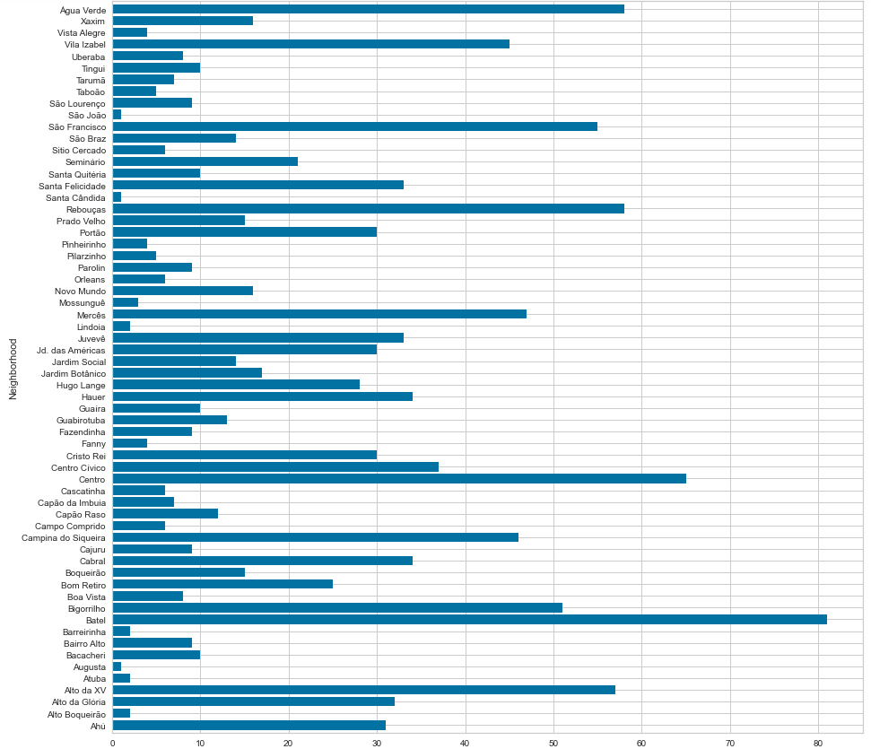
Analisys – Restaurants per Neighborhood

Slide 12
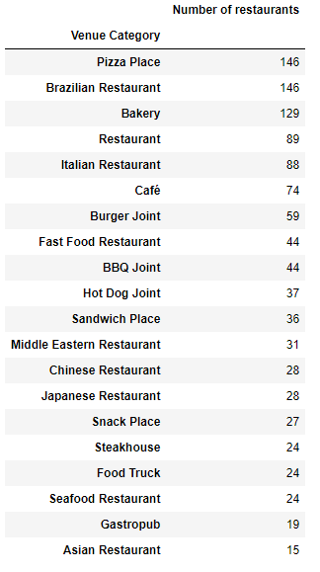
Analisys – Restaurants per Category

Slide 13
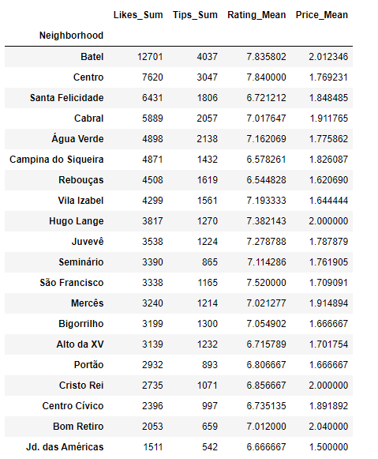
Analisys – Statistics per Neighborhood
Restaurant statistics obtained from Foursquare and grouped by neighborhood

Slide 14
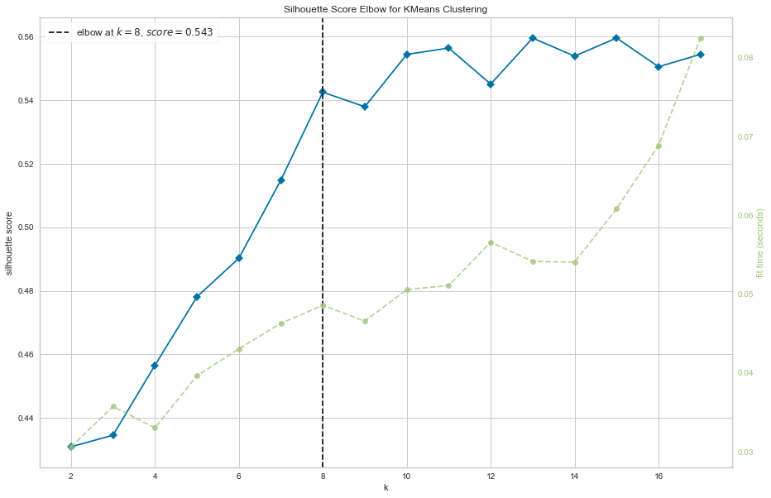
Analisys – K-Means Clustering - KElbow
*Elbow at 8 clusters

Slide 15
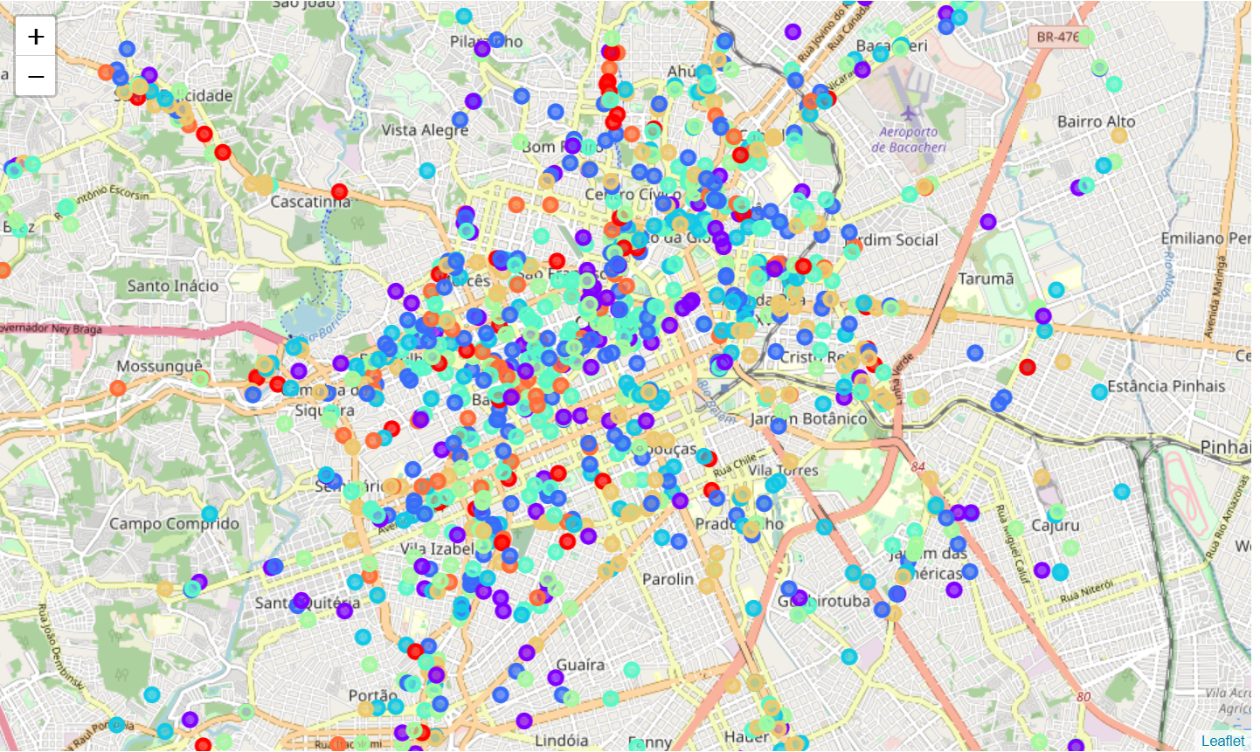
Analisys – K-Means Clustering - Clusters
*Cluster with Good and Cheap restaurants is number 1, the purple one

Slide 16
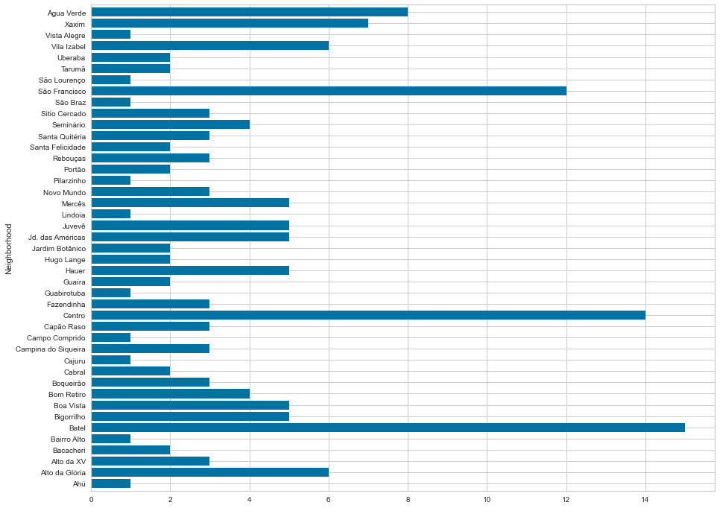
Analisys – K-Means Clustering – Cluster 2
*Number of restaurants per neighborhood

Slide 17
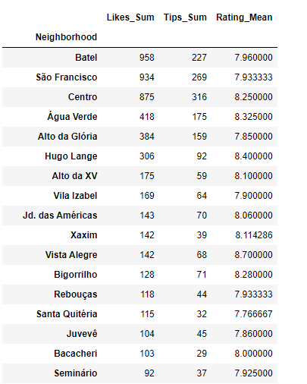
Analisys – Good and Cheap Restaurants
*Statistics of Good and Cheap restaurants per neighborhood

Slide 18
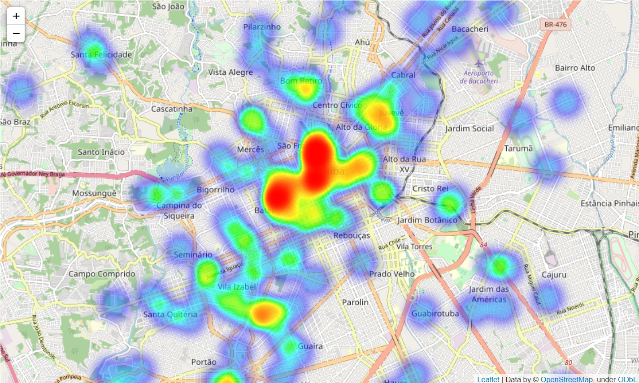
Analisys – Heatmap of G&C Restaurants
*Statistics of Good and Cheap restaurants per neighborhood

Slide 19
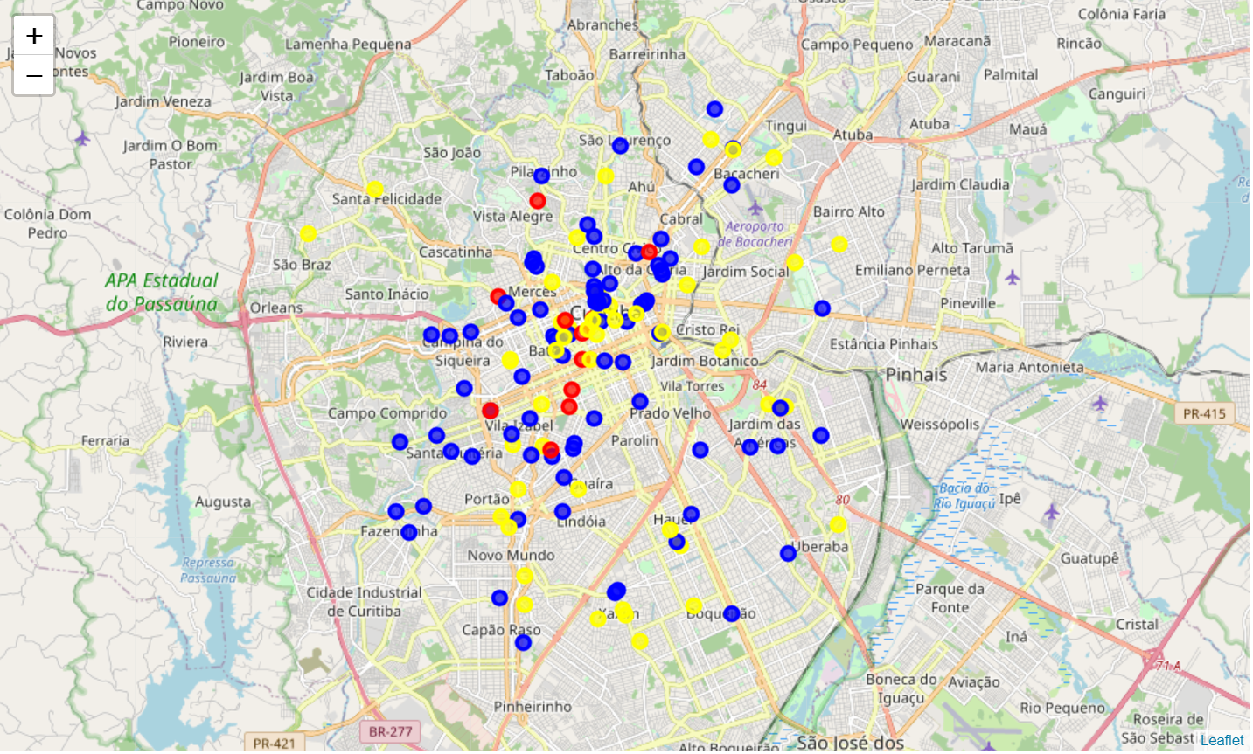
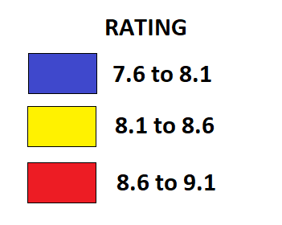
Analisys – Map of G&C Restaurants
*Statistics of Good and Cheap restaurants per neighborhood

Slide 20
Conclusion
Purpose of this project was to create a Curitiba guide of where to Eat for Cheap. During the analysis, several important statistical features of the boroughs and the restaurants were explored and visualized. Furthermore, clustering helped to identify and highlight the group of restaurants we are looking for, and with the Heatmap and some statistics we have identified the region between the three neighborhoods of Centro, Batel and São Francisco as being of greatest interest for our goal. To refine our proposal, we have identified the possibility to rank the restaurants from this cluster based on their rating, to finally create the interactive map, our final objective.

